Slide 1
Laravel Blade Template Layouts
Course Code: CSC 4182
Course Title: Advanced Programming In Web Technologies
Dept. of Computer Science
Faculty of Science and Technology
Lecture No: | 18 | Week No: | 11 | Semester: | Summer 2020-2021
Lecturer: | MD.AL-AMIN; alamin@aiub.edu

Slide 2
Lecture Outline
Laravel Layouts
Converting Html Template In Laravel App
File Upload

Slide 3
Laravel Layouts
Topic sub heading..
Two of the primary benefits of using Blade are template inheritance and sections.
Since most web applications maintain the same general layout across various pages, it's convenient to define this layout as a single Blade view
There are 2 directives @section and @yield.
The @section directive, as the name implies, defines a section of content.
The @yield directive is used to display the contents of a given section.
When defining a child view, use the Blade @extends directive to specify which layout the child view should "inherit".
Views which extend a Blade layout may inject content into the layout's sections using @section directives.

Slide 4
Example
<html>
<head>
<title>App Name</title>
</head>
<body>
@section('sidebar')
This is the master sidebar.
@show
<div class="container">
@yield('content')
</div>
</body>
</html>
@extends('layouts.app')
@section('sidebar')
@parent
<p>This is appended to the master sidebar.</p>
@endsection
@section('content')
<p>This is my body content.</p>
@endsection
Master Layout stored in
resources/views/layouts
Named as app.blade.php
Child Layout
The content of child layout will be placed here

Slide 5
Converting Html Template In Laravel App
Topic sub heading..
Now we will apply the blade templates feature to our project.
We will add header and footer for all pages in our project.
Create a new folder in resources/views named as layouts.
Create a file named app.blade.php in it.
Define the structure of our pages in app.blade.php
<html>
<head></head>
<body>
<div>
<h1>Welcome to Demo Laravel</h1>
</div>
<div>
@yield('content')
</div>
<div>
<h3>Advanced Programming in WT</h3>
</div>
</body>
</html>
While defining section we need to give this name

Slide 6
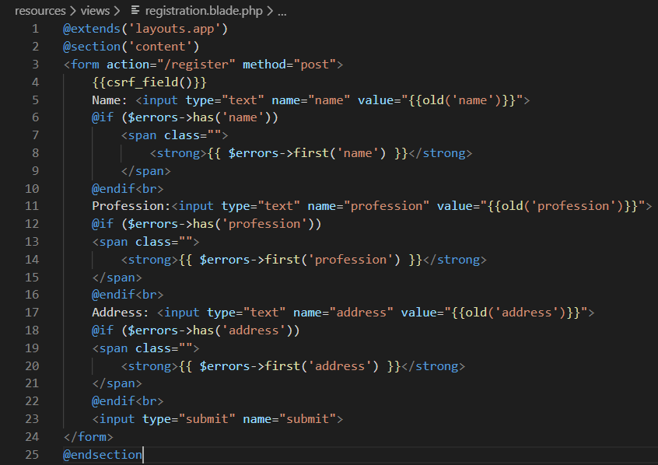
Converting HTML template
In our registration page modify as below.
The name we gave in master layout
Extending Layout
Defining Section to yield

Slide 7
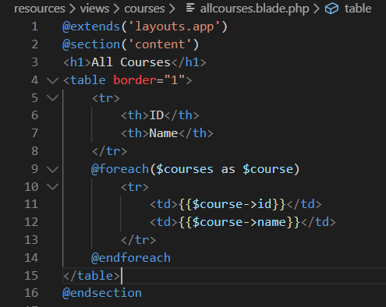
Converting HTML template
In our allcourses page modify as below.
The name we gave in master layout
Extending Layout
Defining Section to yield

Slide 8
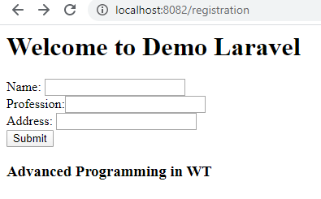
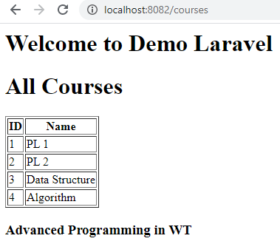
Output

Slide 9
File Upload
Topic sub heading..
The public disk is intended for files that are going to be publicly accessible. By default, the public disk uses the local driver and stores these files in storage/app/public
To make them accessible from the web, you should create a symbolic link from public/storage to storage/app/public
To create the symbolic link, you may use the storage:link Artisan command
php artisan storage:link
The URL of this file can be created using asset helper
echo asset('storage/file.txt');
Laravel makes it very easy to store uploaded files using the store method on an uploaded file instance.
The path to the file will be returned by the store method so you can store the path, including the generated file name, in your database.
$path = $request->file('avatar')->store('avatars');

Slide 10
File Upload
If you would not like a file name to be automatically assigned to your stored file, you may use the storeAs method. which receives the path, the file name, and the (optional) disk as its arguments.
$path = $request->file('avatar')->storeAs(
'avatars', $request->user()->id
); //avatars is the folder name and file stored as user id
If you would like to get original name of the uploaded file, you may do so using the getClientOriginalName method
$name = $request->file('avatar')->getClientOriginalName();
The extension method may be used to get the file extension of the uploaded file
$extension = $request->file('avatar')->extension();
The delete method accepts a single filename or an array of files to remove from the disk
Storage::delete('file.jpg');
Storage::delete(['file.jpg', 'file2.jpg']);

Slide 11
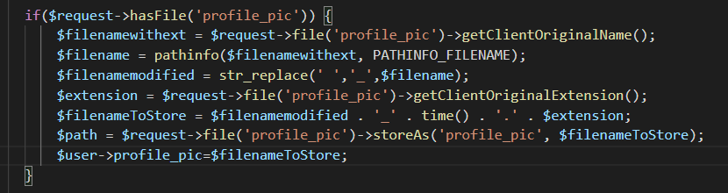
Example

Slide 12
Books
PHP Advanced and Object-Oriented Programming, 3rd Edition; Larry Ullman; Peachpit, Press, 2013
PHP Objects, Patterns and Practice, 5th Edition; Matt Zandstra; Apress, 2016
Learning PHP, MySQL, JavaScript and CSS, 2nd Edition; Robin Nixon; O’Reilly, 2009
Eloquent JavaScript: A Modern Introduction to Programming; Marijn Haverbeke; 2011
Learning Node.js: A Hands On Guide to Building Web Applications in JavaScript; Marc Wandschneider; Addison-Wesley, 2013
Beginning Node.js; Basarat Ali Syed; Apress, 2014

Slide 13
References
https://laravel.com/docs/7.x/blade
https://laravel.com/docs/7.x/filesystem
https://laravel.com/docs/7.x/filesystem#file-uploads

Slide 14
Thank You!

